Slide 1

Breast Cancer Prediction
Malignant or Benign?
Team #3 Emily Kabban & Vineel Busi

Slide 2
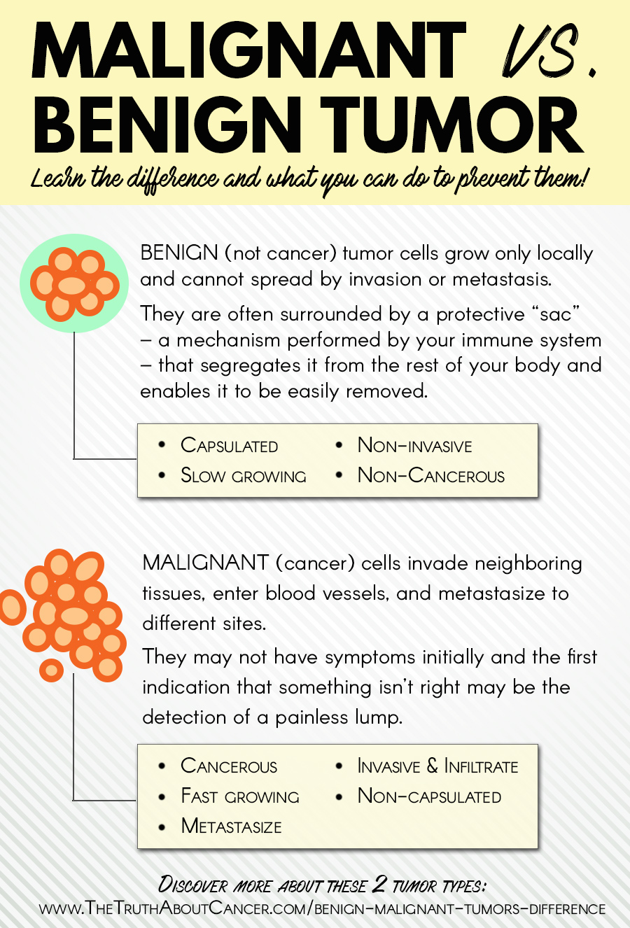
Statement of Problem
Goal:
Create a working model for determining if cellular breast anomaly is benign or malignant
There are several observable cell properties that indicate whether a tumor is cancerous
Can we make a model that predicts this?

Slide 3
Data Source & Tools
Data Source:
Breast Cancer Wisconsin (Original) Data Set
UCI Machine Learning Repository
Dr. William H. Wolberg
University of Wisconsin
https://archive.ics.uci.edu/ml/datasets/breast+cancer+wisconsin+(original)
Tools:
Weka (https://www.cs.waikato.ac.nz/ml/weka/)
Microsoft Excel

Slide 4
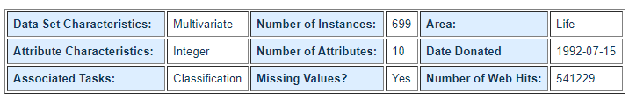
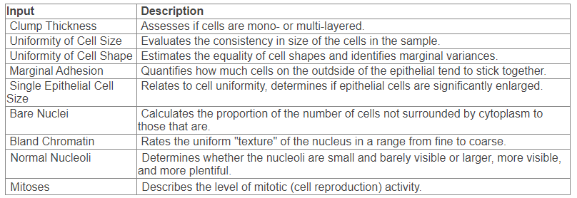
Data Capture
1. Sample code number: id number
2. Clump Thickness: 1 - 10
3. Uniformity of Cell Size: 1 - 10
4. Uniformity of Cell Shape: 1 - 10
5. Marginal Adhesion: 1 - 10
6. Single Epithelial Cell Size: 1 - 10
7. Bare Nuclei: 1 - 10
8. Bland Chromatin: 1 - 10
9. Normal Nucleoli: 1 - 10
10. Mitoses: 1 - 10
11. Class: (2 for benign, 4 for malignant)

Slide 5
Cleaning & Integration
Data Cleaning
The data had previously been updated to fill in missing values
All values were consistent
Data quality was acceptable
Widely used data repository
Integration
No integration was necessary

Slide 6
Sampling & Preprocessing
Sampling
With only 699 instances, sampling was not required for this data
Preprocessing
Removed the ID attribute -- unnecessary attribute used to identify individuals
Converted class labels to nominal label rather than numeric
2 -> B(enign) 4 -> M(alignant)
Attribute selection algorithms tended to select all attributes besides ID

Slide 7
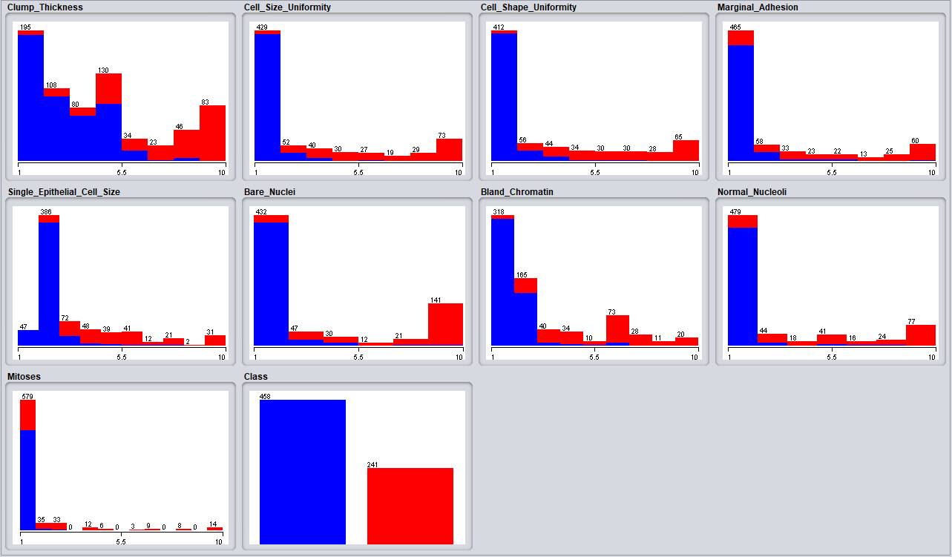
Data Visualization
General trend of skewed to the right
More instances of Benign than malignant
Malignant tend to have high values for each attribute

Slide 8
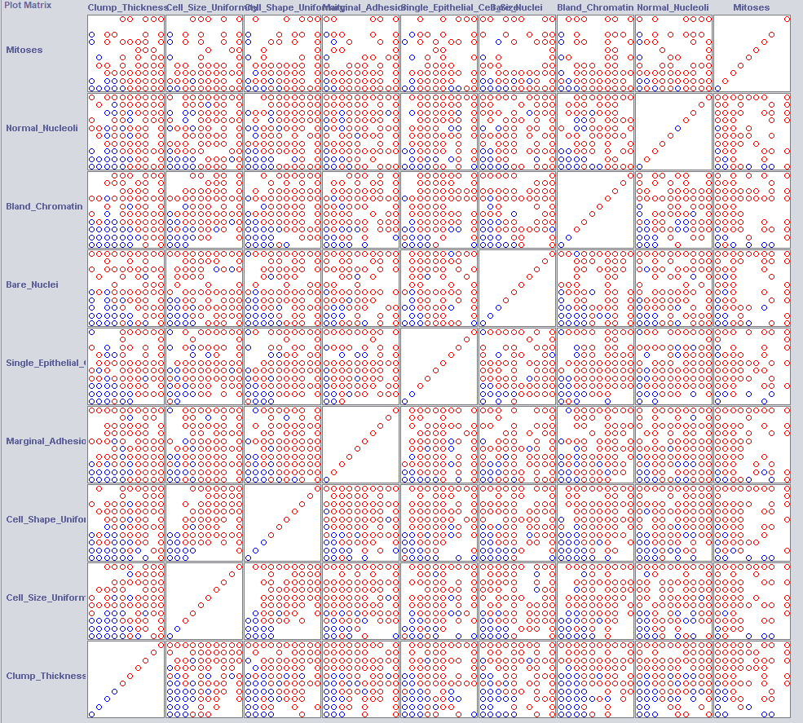
Correlation Matrix showed no clear correlation between attributes
Trend of Benign instances with lower values
Somewhat clear separation of colors for many

Slide 9
Models
Decision Trees
M5P
J48
Deep Learning (DL)
Stochastic Gradient Descent
Support Vector Machine (SVM)
C-SVC
Random Forest (RF)

Slide 10
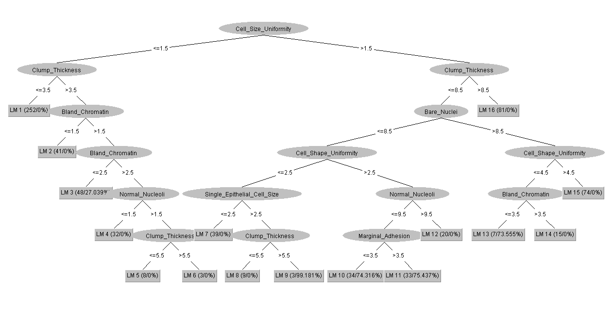
M5P

Slide 11
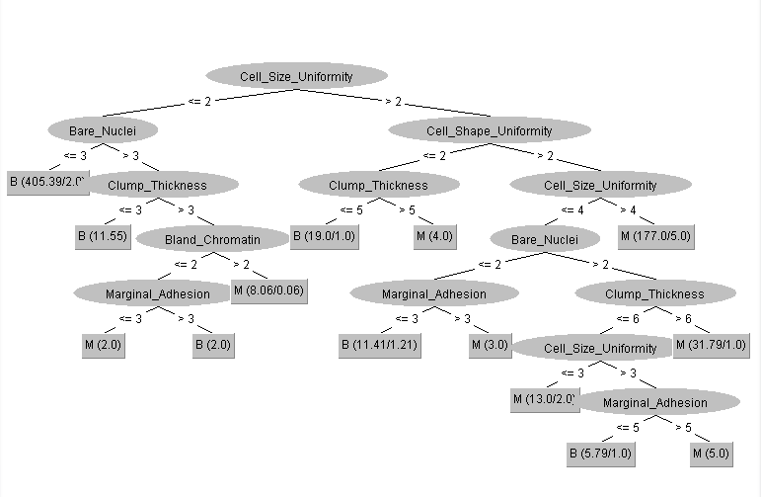
J48

Slide 12
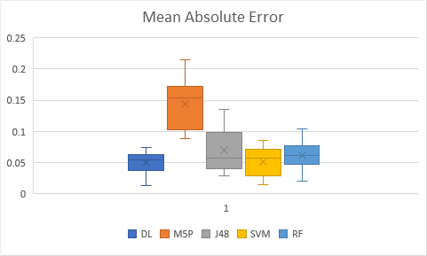
Training & Test Results

Slide 13
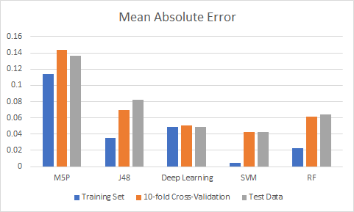

Slide 14
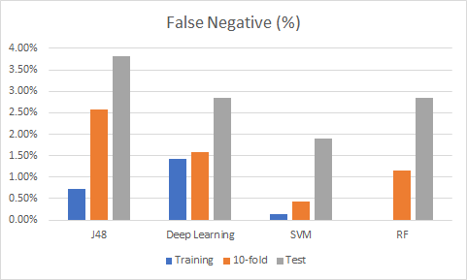
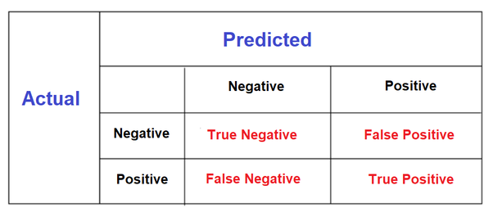

Slide 15
Model Selection
The final choice of classifier was SVM
Relatively low error rate
Lowest Type 2 error rate
Faster than DL
Better suited for smaller data sets
 | B (predicted) | M (predicted)
B | 127 | 5
M | 4 | 74

Slide 16
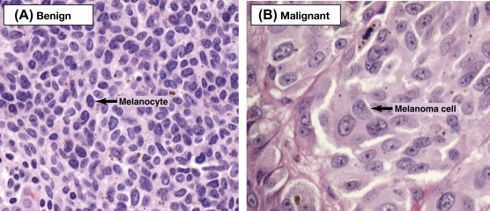
Demo
Demo data created based off of images of benign and malignant cells
Cell_Shape_Uniformity | Marginal_Adhesion | Single_Epithelial_Cell_Size | Bare_Nuclei | Bland_Chromatin | Normal_Nucleoli | Mitoses | Class
2 | 2 | 2 | 2 | 1 | 1 | 1 | B
2 | 3 | 4 | 9 | 4 | 3 | 1 | M

Slide 17
Run Data on SVM
=== Summary ===
Correctly Classified Instances 2 100 %
Incorrectly Classified Instances 0 0 %
Total Number of Instances 2
2/2 Correct!
=== Confusion Matrix ===
a b <-- classified as
1 0 | a = B
0 1 | b = M

Slide 18
Questions?

